Slide 1
Heaps

Slide 2
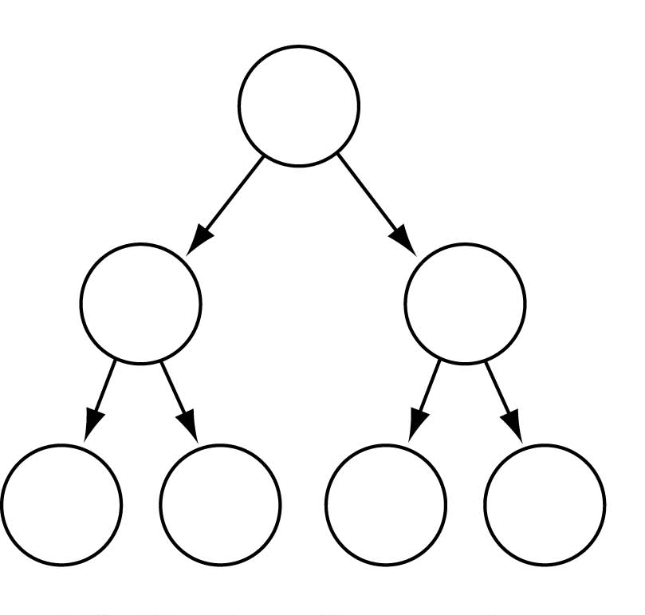
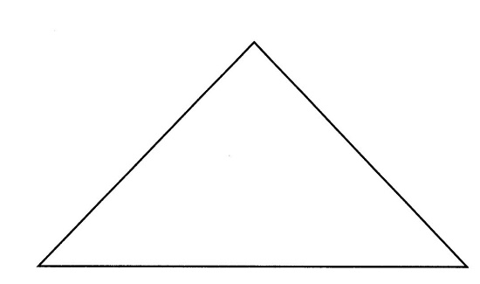
Full Binary Tree
Every non-leaf node has two children
All the leaves are on the same level
Full Binary Tree

Slide 3

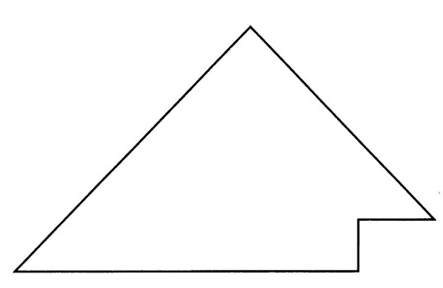
Complete Binary Tree
A binary tree that is either full or full through the next-to-last level
The last level is full from left to right (i.e., leaves are as far to the left as possible)
Complete Binary Tree

Slide 4
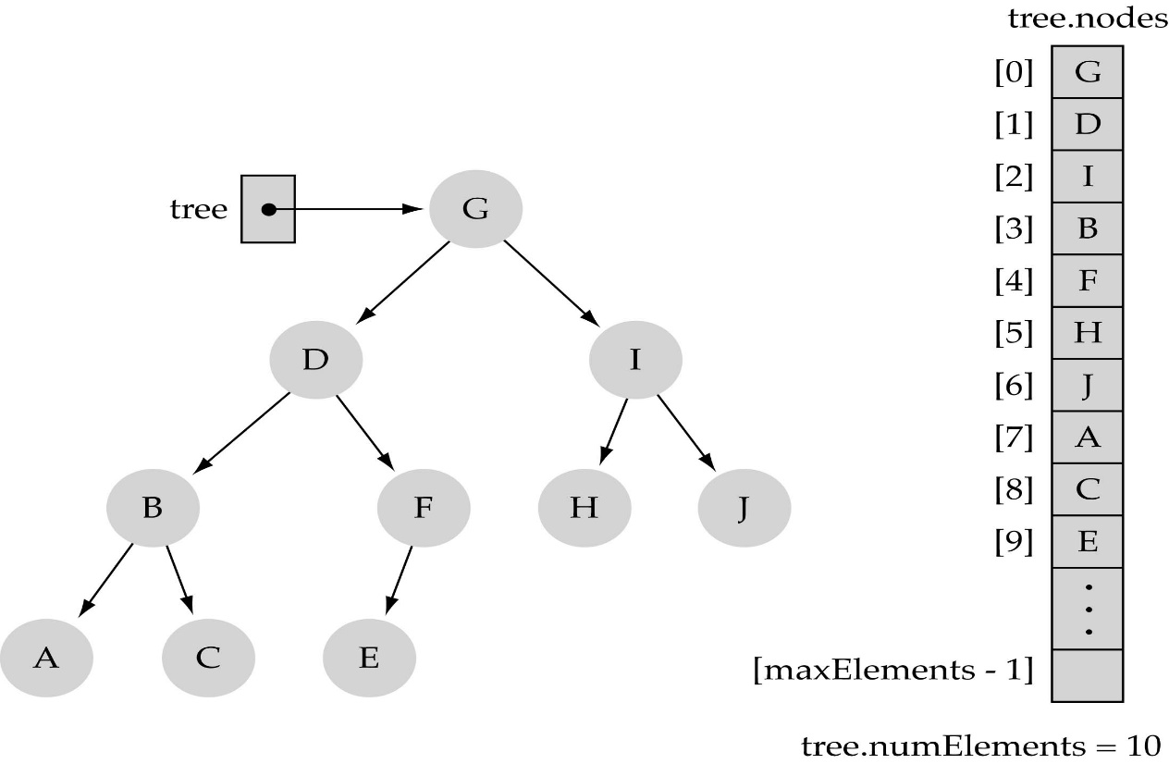
Array-based representation of binary trees
Memory space can be saved (no pointers are required)
Preserve parent-child relationships by storing the tree elements in the array
(i) level by level, and (ii) left to right
0
1
2
4
5
6
3
7
8
9

Slide 5
Array-based representation of binary trees (cont.)
Parent-child relationships:
  left child of a node at i = 2*i+1
  right child of a node at i = 2*i+2
  parent node of node at i = (i-1)/2]

Slide 6
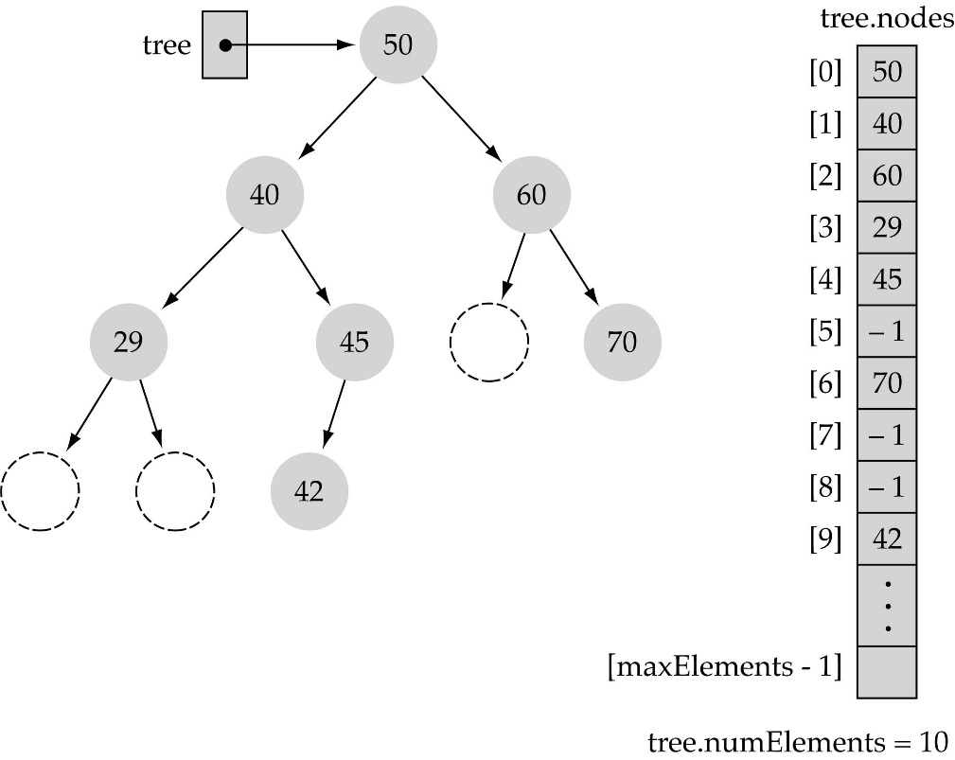
Array-based representation of binary trees (cont.)
Full or complete trees can be implemented easily using an array-based representation (elements occupy contiguous array slots)
"Dummy nodes" are required for trees which are not full or complete

Slide 7
What is a heap?
It is a binary tree with the following properties:
  Property 1: it is a complete binary tree
  Property 2: the value stored at a node is greater/lesser or equal to the values stored at the children
  (heap order property)

Slide 8
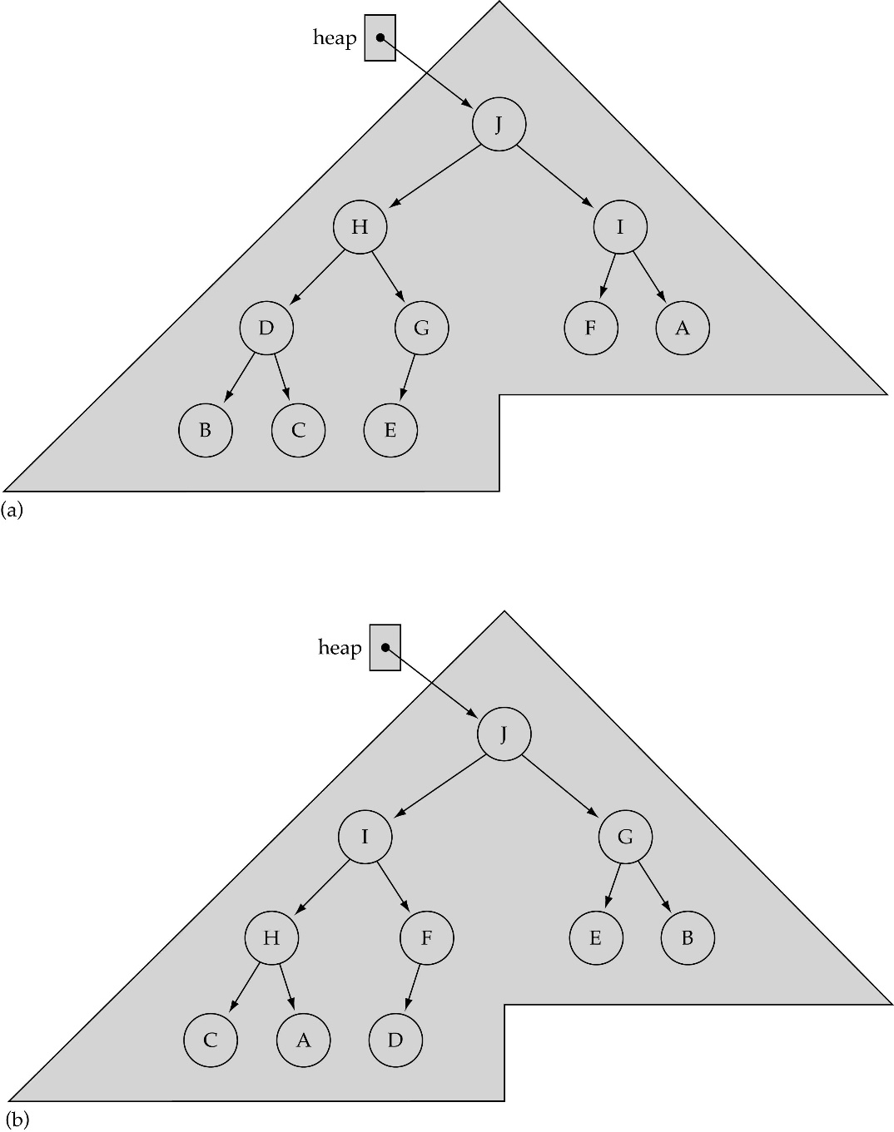
What is a heap? (cont.)

Slide 9
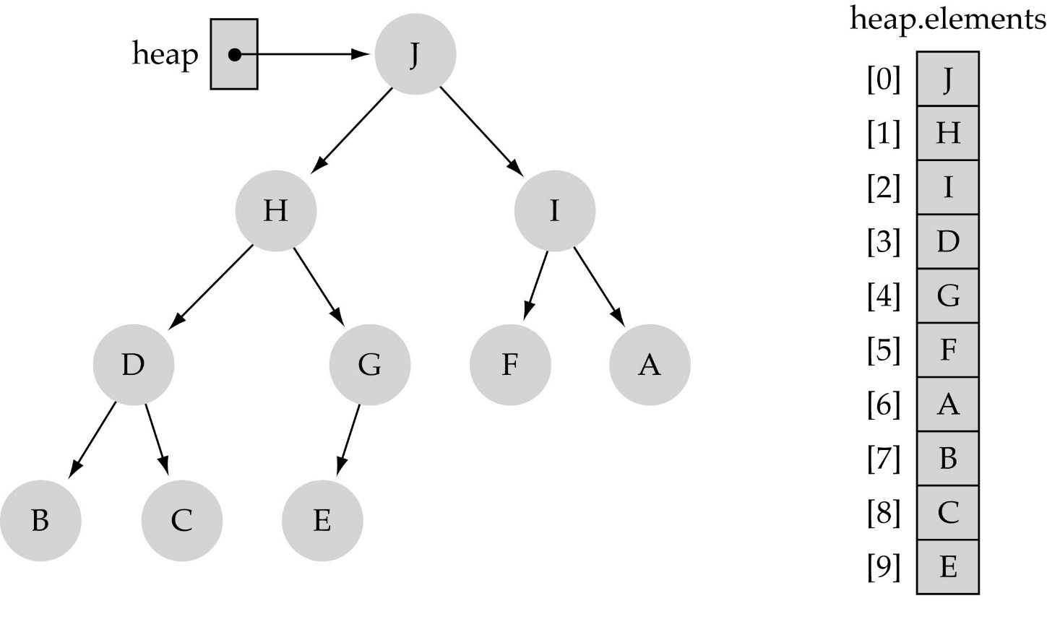
Largest heap element
From Property 2, the largest value of the heap is always stored at the root

Slide 10
Heap implementation using array representation
A heap is a complete binary tree, so it is easy to be implemented using an array representation

Slide 11
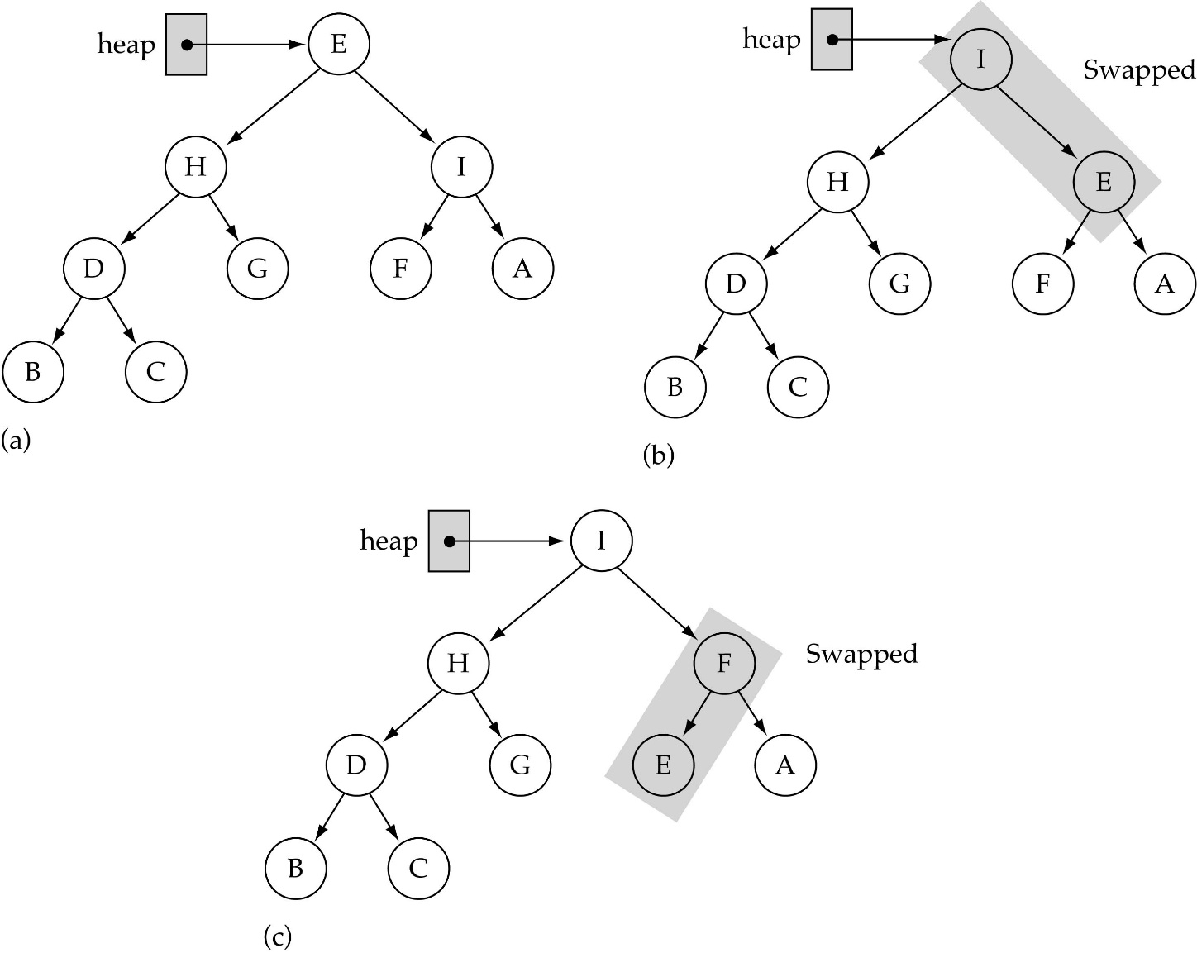
The ReheapDown function
(used by deleteItem)
Assumption:
heap property is
violated at the
root of the tree

Slide 12
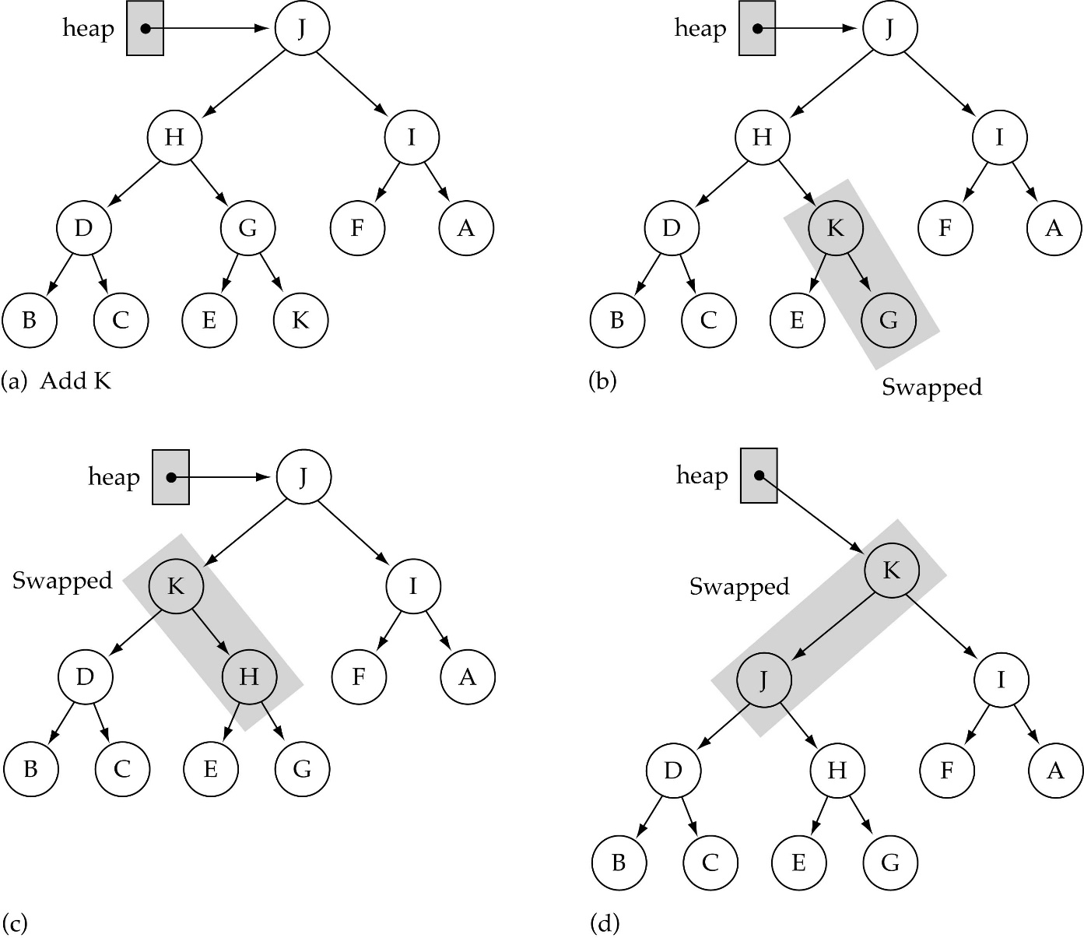
The ReheapUp function
(used by insertItem)
bottom
Assumption:
heap property is
violated at the
rightmost node
at the last level
of the tree

Slide 13
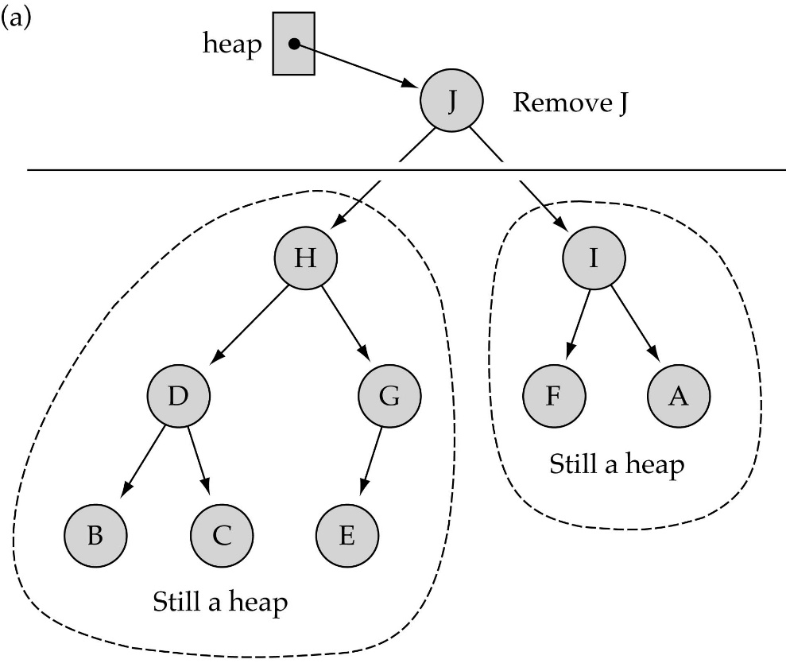

Removing the largest element from the heap (cont.)

Slide 14

Removing the largest element from the heap (cont.)

Slide 15
Inserting a new element into the heap
(1) Insert the new element in the next bottom leftmost place
(2) Fix the heap property by calling ReheapUp

Slide 16
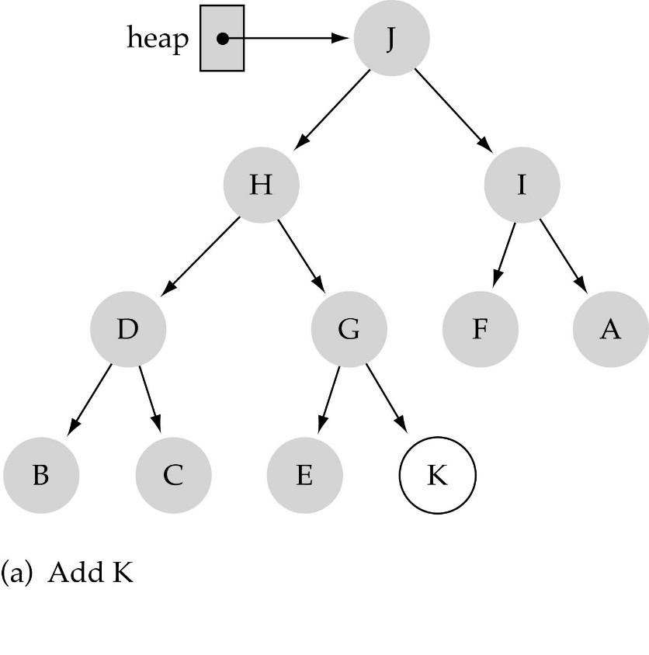
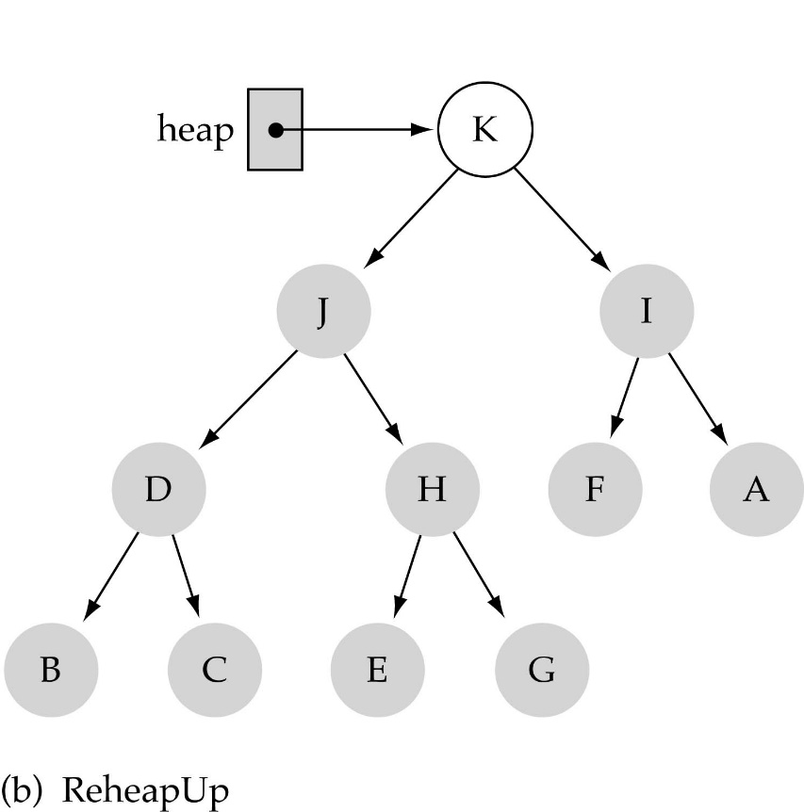
Inserting a new element into the heap (cont.)

